Slide 1
LG M48F Supply Plan and Metals Dashboards Overview
Chiemi Kato
January 2019

Slide 2
Introduction
LG M48F Supply Plan
Metals Dashboards
Documentation structure needed to align LG Chem’s production capacity with Tesla’s projected cell demand
Goal:
GF3 operational planning and analysis – to be able to identify shortages in production and room for improvements in cell supply
Challenges:
No framework for operational analysis between Tesla and LG
We weren’t exactly sure how our vehicle/cell production and supply would be impacted by LG’s production capacity
Sarah was using an excel-based dashboard that came with a long list of constraints
She asked for a transition to Power BI interface, which would allow for interactive dashboards
Challenges:
Time inefficient
Not all the way functional tool

Slide 3
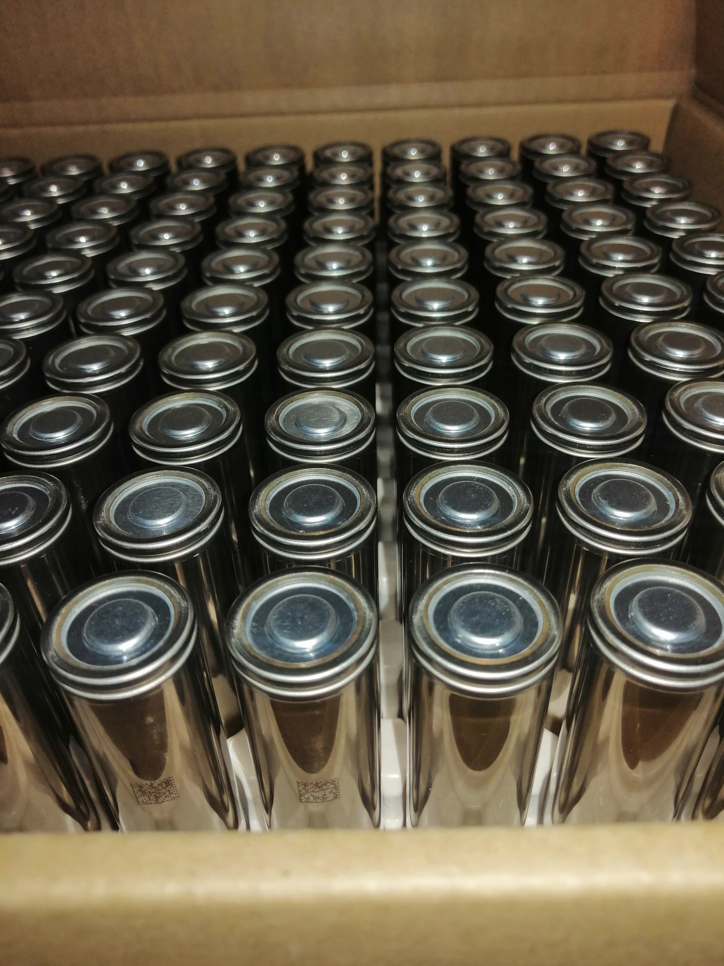
LG M48F Supply Plan Process/Improvements
Integrated information from finance to provide different demand-side scenarios
Set up an excel framework for LG to be able to provide more details (ie weekly production data and separated by assembly line)
Created scenario options/toggles to simulate and identify how the supply will be impacted by design and/or production changes

Slide 4
Demo

Slide 5
Scenario Options
Demand
$$Supply + Demand = Delta$$
Capacity
Top Cap
Cathode
Anode
Pack Capacity
Build Target

Slide 6
Outcome/Final Benefits
Unified platform for teams to simulate and evaluate their own ideas
Improves interdepartmental and inter-company communication and understanding

Slide 7

Metals Dashboards Process/Improvements
- Restructured the way source files were stored (SQLite database) so that visualizations would not be disrupted with data updates
- Used python to automate the data cleaning and transformations before loading to Power BI
- Utilized SharePoint/Power BI integration by hosting the visualizations in SharePoint Battery GSM page

Slide 8
Metals Dashboards Process/Improvements
Before | After
Manual dragging of formulas to include new data Not user friendly – came with list of instructions/easy to mess up | Python program written for data cleaning and processing Interactivitive date slicers and hover data for a deeper dive into the details Visualizations embedded in Battery GSM SharePoint page

Slide 9
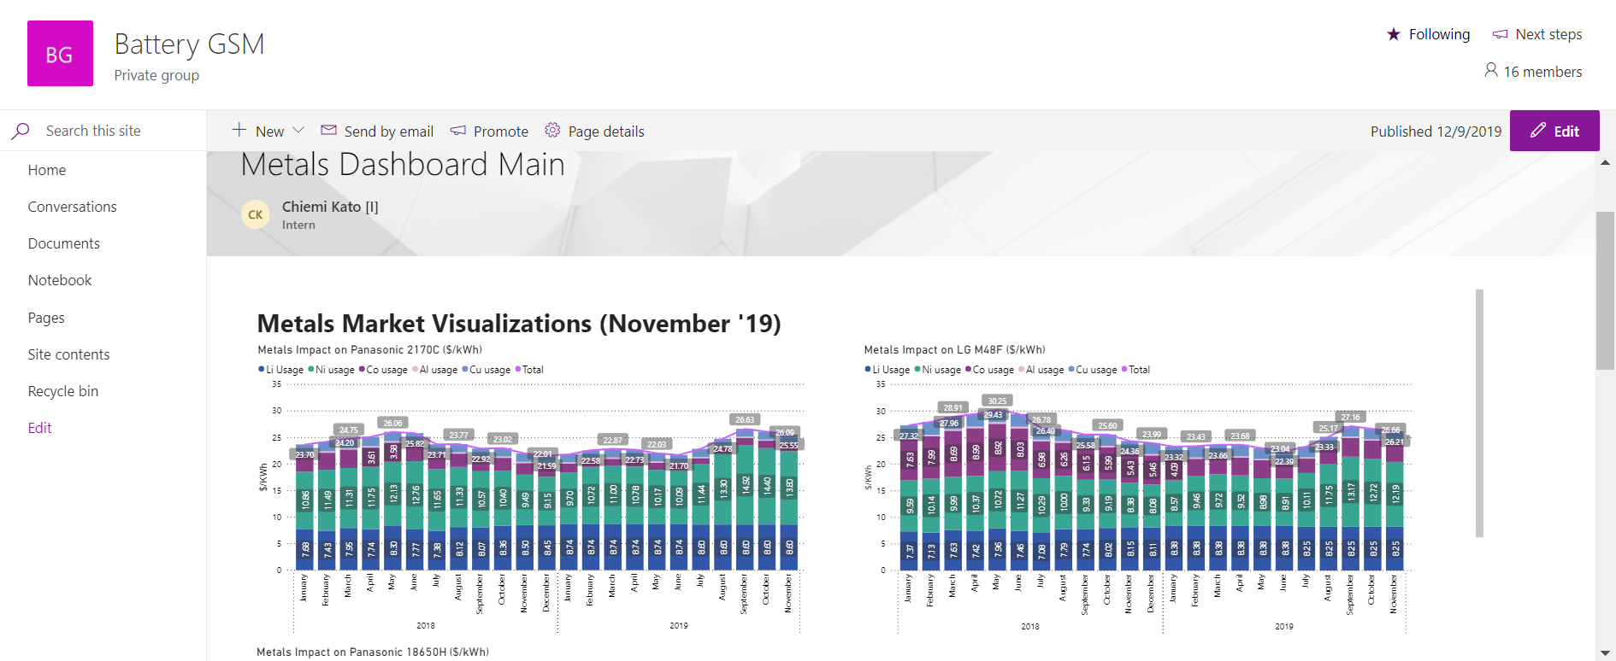
How to Access? (After your account is approved by Katie) go to SharePoint Battery GSM page and click “Pages” tab to the left.

Slide 10
Demo

Slide 11
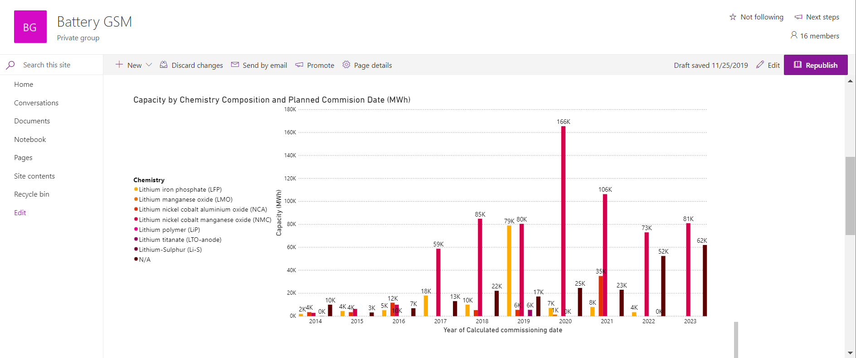
THE END
Check it out!

